Slide 1

ePortfolio by Isabella Schmidt
Frei verwendbar

Slide 2

Table of Contents
Basics about AngularJS
Benefits of the Framework
Key Features of AngularJS
Useful Commands
MVC-Implementation
Two-Way-Data-Binding
Coding Session

Slide 3
Basics about AngularJS
Client-Side JavaScript Framework
Open Source
Release: 2009 by Google
Designed for Single Page Applications
Build properly architectured and maintenable web applications

Slide 4
Benefits of the Framework
Enhances HTML attaches directives, custom tags, attributes
Reduction of code
Reusable components
Fully extensible, works well with other libraries
Uses the MVC-Pattern

Slide 5
Key Features of AngularJS
Data-Binding
automatic synchronization of data between model and view components
Routing
concept of switching views
Directives
attach specific behavior to DOM elements
Makes testing easier
UNIT tests can be done easily

Slide 6
Useful Commands
ng-Click: binds a Click-Event to a html-Element
ng-init: initialisation in starting phase
ng-repeat: „for-loop“, iterates over the property of an object

Slide 7
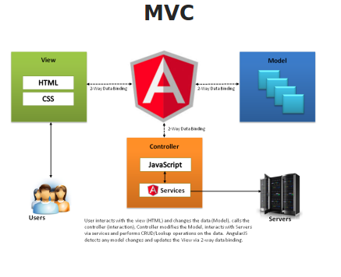
MVC-Implementation

Slide 8
MVC-Implementation
Model:
$scope: carries data between all pieces of the system
binds input, select or textarea to the scope
<input type=“type“ ng-model= “modelName“>

Slide 9
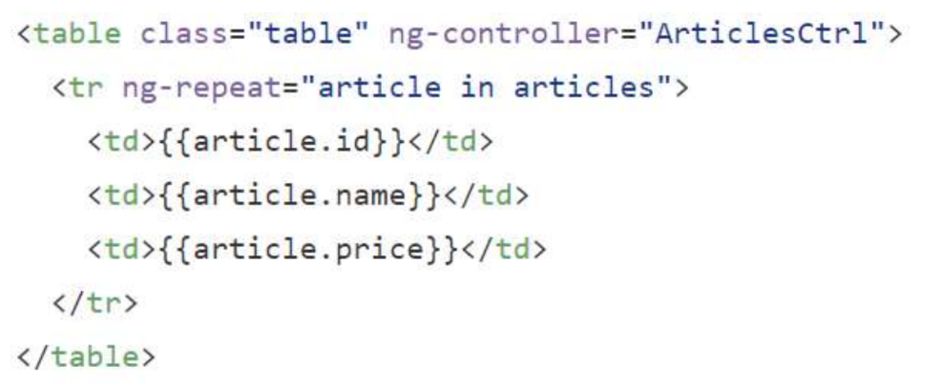
MVC-Implementation
View:
Contains visual layout and presentation (HTML)
References $scope objects

Slide 10
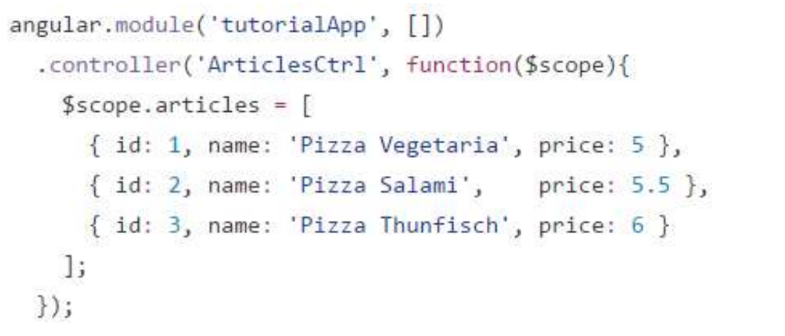
MVC-Implementation
Controller:
Performs the Two-Way-Data-Binding

Slide 11
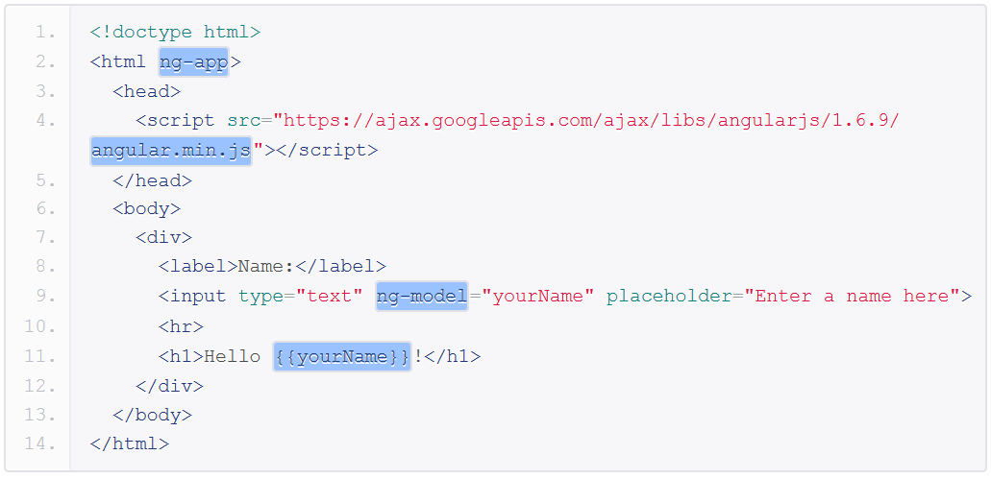
MVC-Implementation

Slide 12
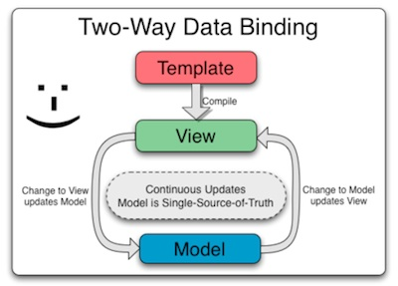
Two-Way-Data-Binding

Slide 13

Coding Session

Slide 14
Sources
https://www.htmlcenter.com/blog/what-is-2-way-binding-in-angular-js/
https://www.w3schools.com/angular/default.asp
https://angularjs.org/
https://www.tutorialspoint.com/angularjs/angularjs_overview.htm
https://www.hongkiat.com/blog/angularjs-frameworks/
https://docs.angularjs.org/guide/directive
https://www.tutorialspoint.com/angularjs/angularjs_mvc_architecture.htm

Slide 15


